Slide 1
Soldering Station
Presentator:
Asadullah Chaudhry

Slide 2
Content
1
Introduction
Material and methods
Software
Price list
Results
Discussion

Slide 3
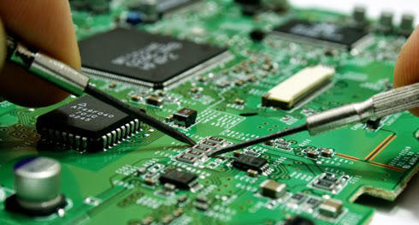
Introduction
2
Which device did I build?
What does it do?
Notes:
- Which device did I build?
--> I build a Soldering station with a temperature regulation.
---> it means that you can choose which temperature you want.
- What does it do?
--> A soldering sation is a power soldering device designed for electronic components soldering.
---> It connect multiple things toghter. like components with a pcb or 2 piece of matels.

Slide 4
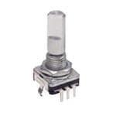
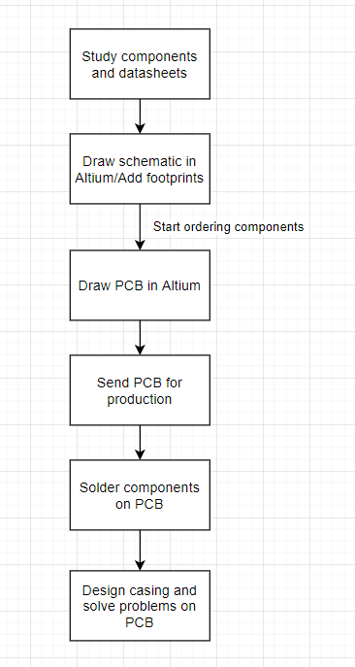
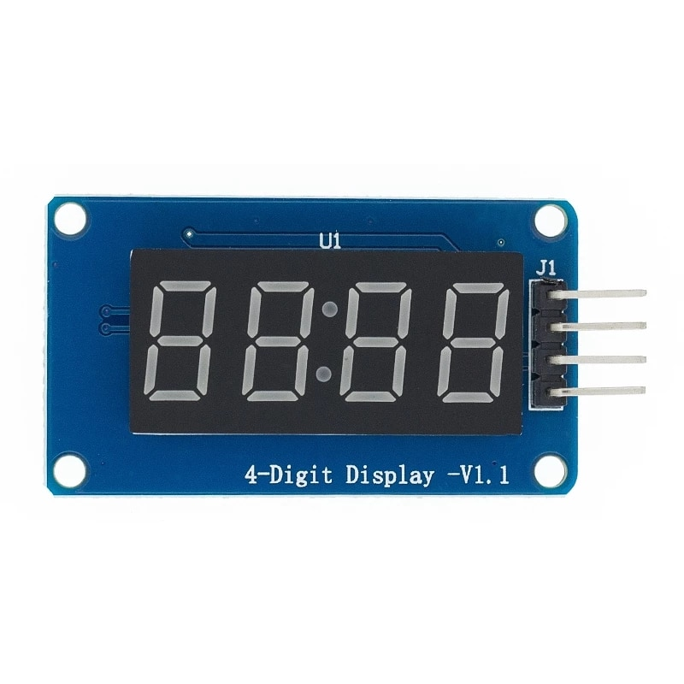
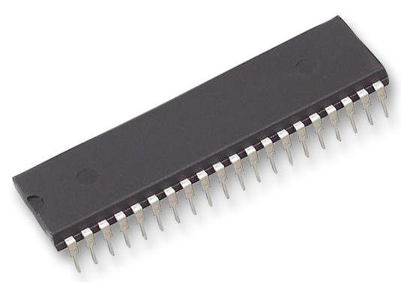
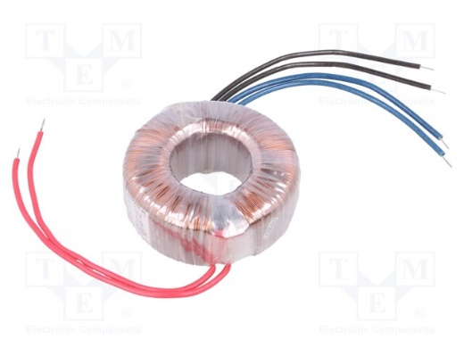
Material and methods
3
TM1637
ATMEGA4809-PF
Microprocessor
Encoder
Temperature regulation
50°C – 450°C
Power supply
2 x 12 V
Flowchart
Notes:
- TM1637
--> Is a led display of 4 bits it mean you can see 4 numbers on the led. We used led display instead of oled screen
because you have to program a oled display and led display is also cheaper.
---> You can see the max and minium temperature on the led. Mini tem is 50 C and it can go to 450 C.
- ATMEGA4809-PF
--> Is a microprocessor it's nessery to have this on your project becaus all the componenent are connected to this.
---> what is a microprocessor? it's actualy simple you can say it's a brain of this project, this project won't work without it.
- Encoder
--> An ecoder is also nessery becaus it regulate the temperature.
- Power supply
--> this power suply is nessery becaus to get high temperature we need enough voltage. but the power supply is really havy
and makes your soldering station also really havy.
- Flowchart
--> The first step in the building process is to study the components. Because some of them are smd and some through holes.
---> The second step is to draw schemetic it is really important because before ordring the componentes you need to check if they are the right once.
after that i draw pcb design and sended to a company to print my pcb. it took a while because there were some problem.
after I had to solder the components to the pcb and at the end i designed a 3d case for my pcb.

Slide 5
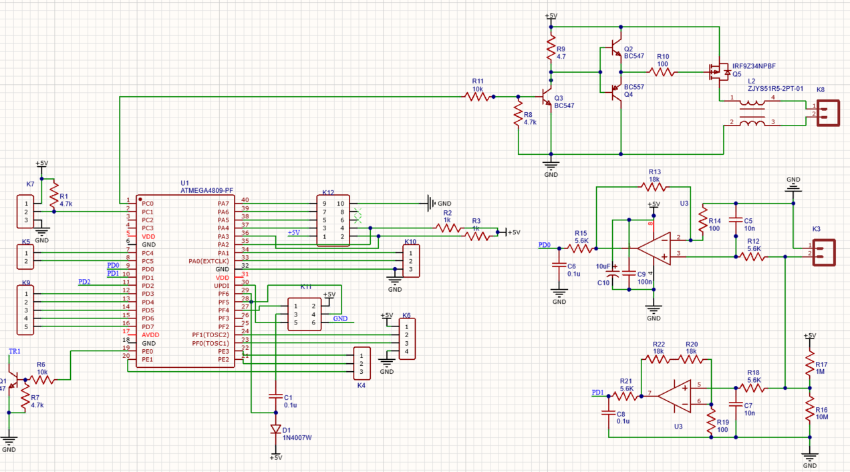
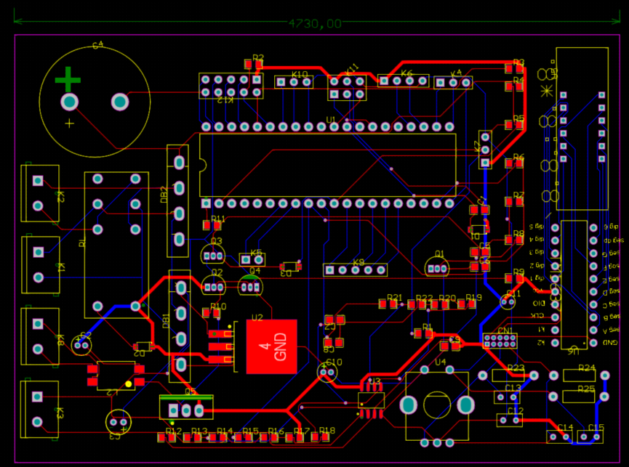
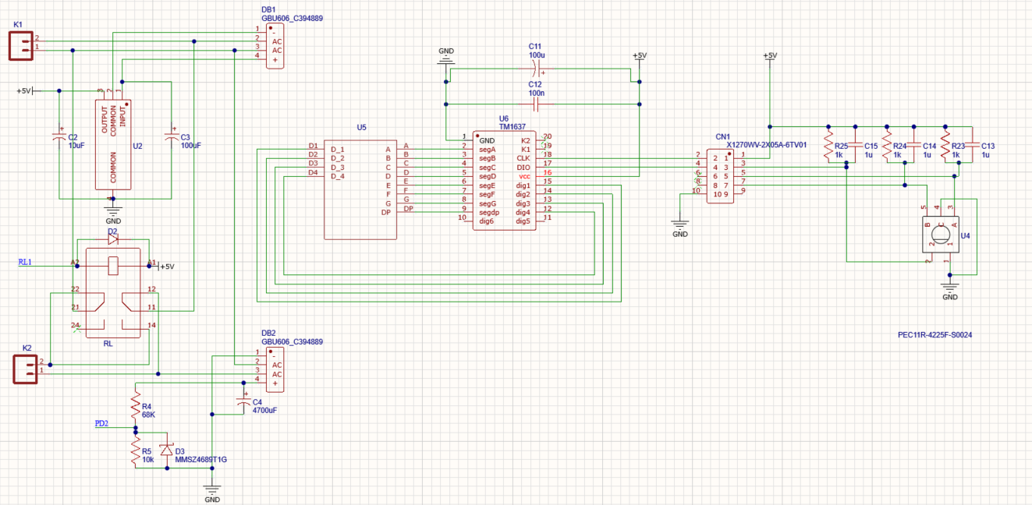
Software
4
Altium
Schematic
PCB design
Top layer
Bottom layer
Notes:
- Altium
--> I made 2 schematic 1 for atmega and the other for the led display becaus it is easier to reae the schematic.
---> There are also all then components that I used in my project. Most of the components are drawn by my self so it took a while to complete it.
- Pcb design
--> the pcb has top layer and the bottom layer the red wires are drawn on the top layer while the blue wires are on the bottom layer.
---> The hardest part was to make pcb design, because the components are really small so that needed a lot of attention, and it had a lot of errors in the beginning, so it took a while to fix the erorrs.

Slide 6
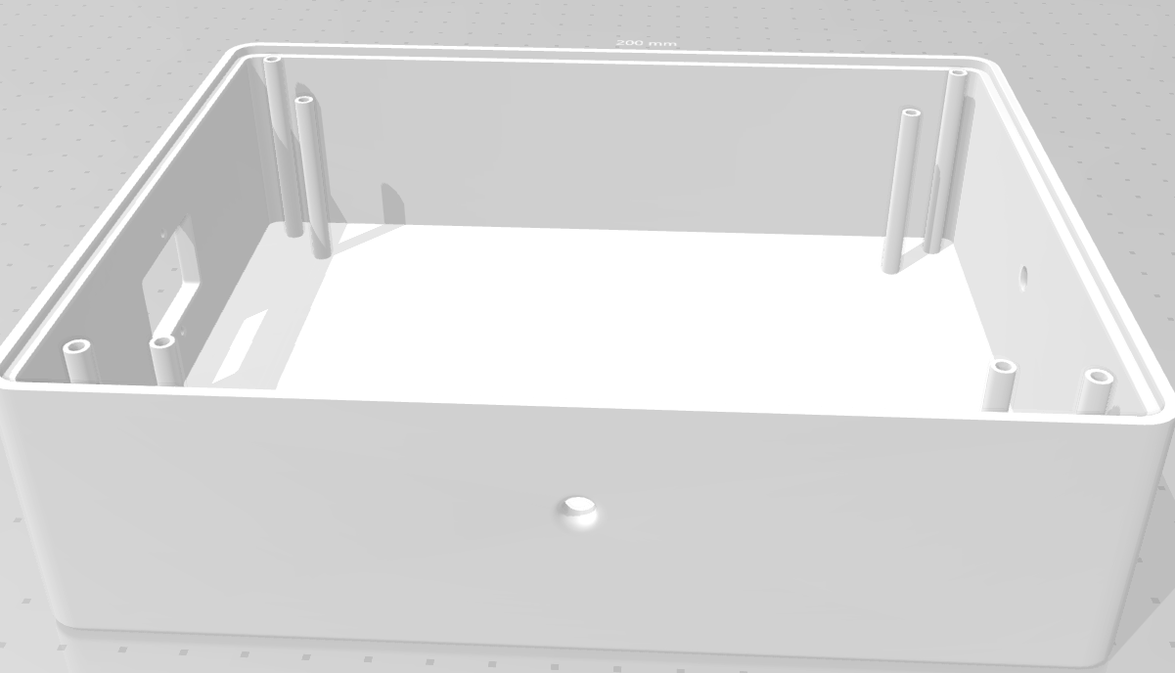
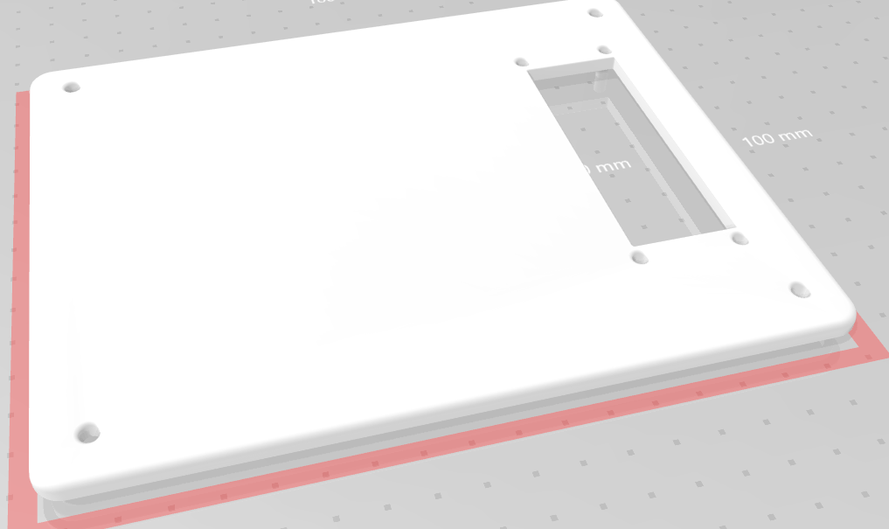
Software
5
Fusion 360
Notes:
- Fusion 360
--> The software we use this year is fusion 360 because its user friendly and you can find a lot on the internet.
---> i designed my box so the pcb would fit in. It is a simple box design. my case is divided in 2 parts
the uper side the lid, it is for the led display so you can see the temperature.
and the box where the pcb will fit and as you can see there are 2 holes one is for the encoder and the other one for the soldering iron,

Slide 7
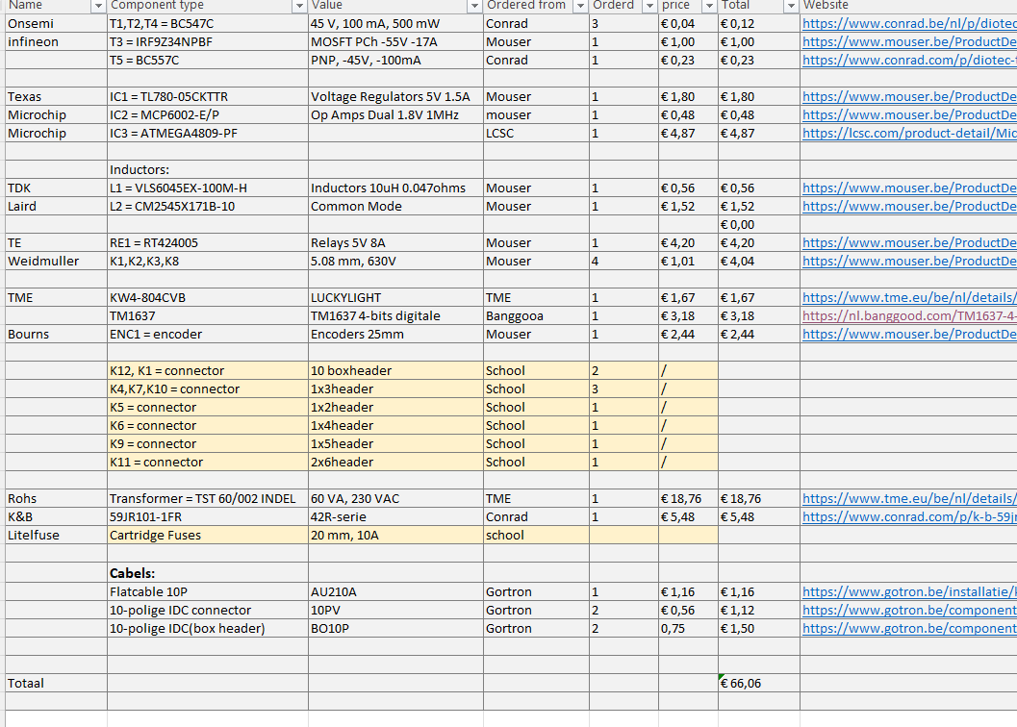
Price List
6
€66

Slide 8
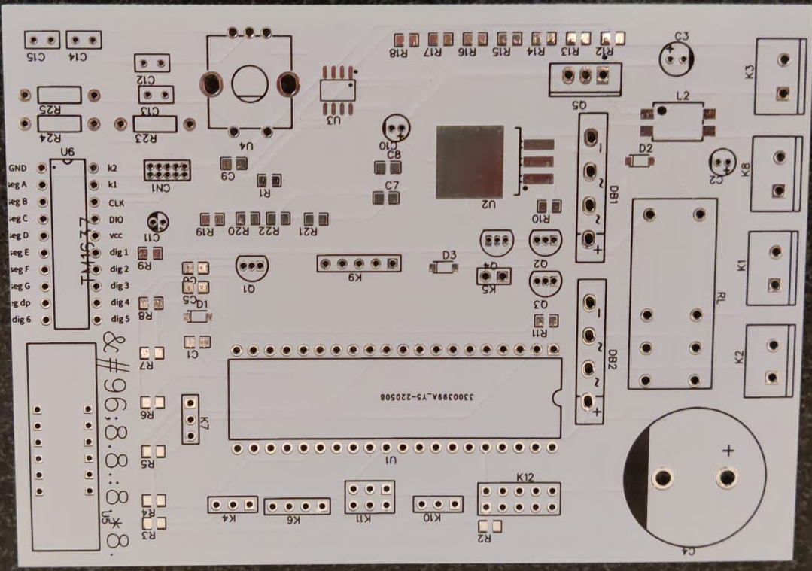
Results
7
PCB
Components
2 weeks
JLCPCB
€ 31
Notes:
- well i can't show you the result becaus i didn't solder yet becaus the pcb didn't arrived on time.
--> it took more then 2 weeks to arrive becaus i orderd with my classe mates but one of them did the wrong pcb so he had to change it again.
---> the shipping to expensive to order it alone. I hope i can finsh this friday.

Slide 9
Discussion
9
Wrong PCB
In transit
Soldering iron
Expensive
Shipping
Notes:
- One of the big problems was the shipments toke too long and some of components were still in transit.
- And some of them weren't avlible so I had to look at different sites and it took it a while.
--> Second problem is it’s too expensive so don’t just take a random project, so look it twice before you order it,
---> I couldn't order the soldering iron on time so I'm not sure if it will arrive.

Slide 10
10
Any Questions?

